Slide 1
Customer Segmentation - A project using UnSupervised Learning
Name: R. Abishek Bhat
Capstone Project Power point Presentation
Email:abishekbhat31@gmail.com
Linkedin: https://www.linkedin.com/in/abishekbhat31/
Github: https://github.com/abishek-bhat

Slide 2
Table of Contents
Problem statement
Understanding The Variable
Methodology
Key finding
How helpful for business

Slide 3
Problem Statement
An automobile company has plans to enter new markets with their existing products
(P1, P2, P3, P4 and P5).
In their existing market, they have to classify all customers into different number of segments.
Then, they can perform segmented outreach and communication for different segment of customers.

Slide 4
Understanding The Variable
Customer I’D
Gender
Age
Annual Income(k$)
Spending Score(1-100)
Since the above Variables are not labelled data, Clustering with the help of unsupervised learning model of machine learning will lead us to best result.

Slide 5
Methodology
Prepare the data.
Data Analysis and Exploration.
Clustering analysis.
Visualization and Interpretation.

Slide 6
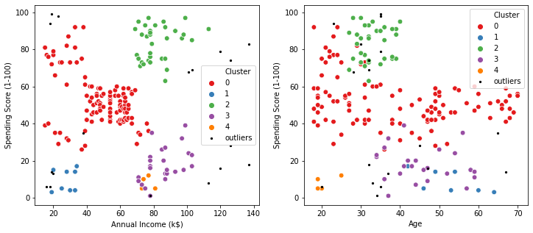
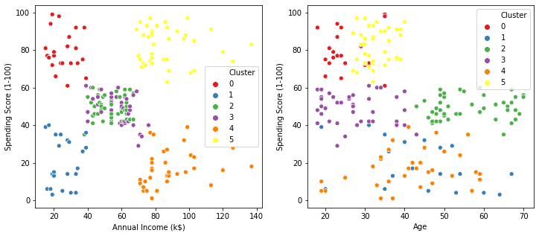
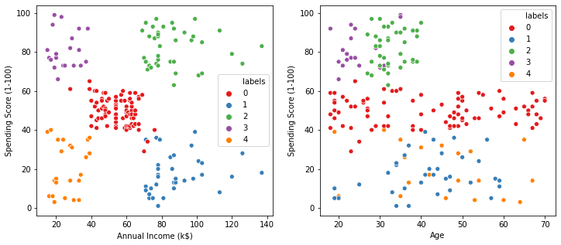
Some Sample Plots

Slide 7
Key Finding
Solution for the question:
clients with low annual income and high spending score
clients with medium annual income and medium spending score
clients with high annual income and low spending score
Technical Key Findings:
K-Means and Affinity Propagation has better result than DBSCAN in this case.

Slide 8
How helpful for business
Targeted Sales.
Efficient Sales.
costs down.
Identifies least and most profitable customers.
Loyal relationships with customers.
Improvement Customer Service.

Slide 9
Thank You

